Slide 1
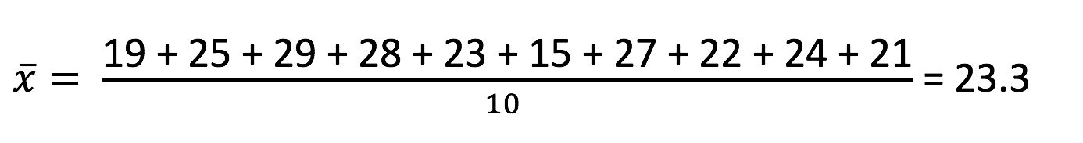
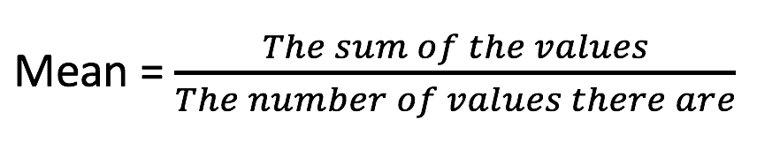
MEAN
Calculating measures of centre and spread
Arithmetic average of the data (or scores)
Measure of its centre
Given a set of numbers:
19, 25, 29, 28, 23, 15, 27, 22, 24, 21

Slide 2
MEDIAN
Calculating measures of centre and spread
The middle value in an ordered set of values.
Example:
23, 24, 23, 25, 23, 26, 27, 28, 28, 23, 28, 22, 26, 28, 25
Reorder:
22, 23, 23, 23, 23, 24, 25, 25, 26, 26, 27, 28, 28, 28, 28
MEDIAN = 25
Odd number of values, the median is the middle value.

Slide 3
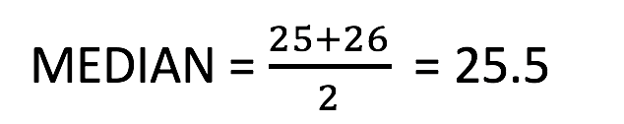
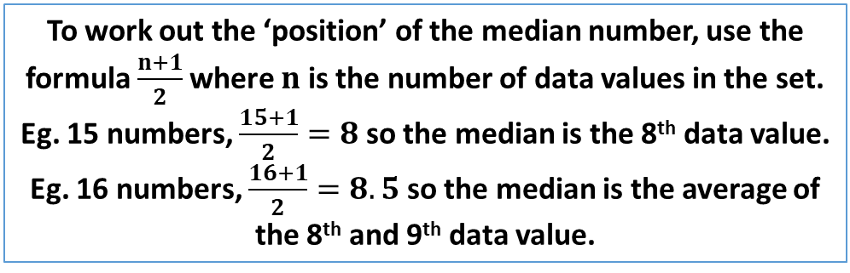
MEDIAN
Calculating measures of centre and spread
To work out the ‘position’ of the median number, use the formula $\frac{n+1}{2}$where $n$ is the number of data values in the set.
Eg. 15 numbers, $\frac{15+1}{2}=8$ so the median is the 8th data value.
Eg. 16 numbers, $\frac{16+1}{2}=8.5$ so the median is the average of the 8th and 9th data value.
Example:
23, 24, 23, 25, 23, 26, 27, 28, 28, 23, 28, 22, 26, 28, 25,26
Reorder:
22, 23, 23, 23, 23, 24, 25, 25, 26, 26, 26, 27, 28, 28, 28, 28
Even number of values, the median is the average of the two middle value.

Slide 4
MODE
Calculating measures of centre and spread
Mode is the value(s) that appears the most in the set of data.
Example:
23, 24, 22, 25, 23, 26, 27, 28, 28, 23, 28, 22, 26, 28, 98
Rearrange:
22, 22, 23, 23, 23, 24, 25, 26, 26, 27, 28, 28, 28, 28, 98
Mode = 28

Slide 5
MODE
Calculating measures of centre and spread
Example:
23, 24, 23, 25, 23, 26, 27, 28, 28, 23, 28, 22, 26, 28, 98
Rearrange:
22, 23, 23, 23, 23, 24, 25, 26, 26, 27, 28, 28, 28, 28, 98
Bimodal, modes = 23 and 28

Slide 6
RANGE
Calculating measures of centre and spread
Range is the difference between the highest and lowest score.
Example:
23, 24, 23, 25, 23, 26, 27, 28, 28, 23, 28, 22, 26, 28, 25,26
Highest = 28 Lowest = 22
RANGE = 28 – 22 = 6

Slide 7
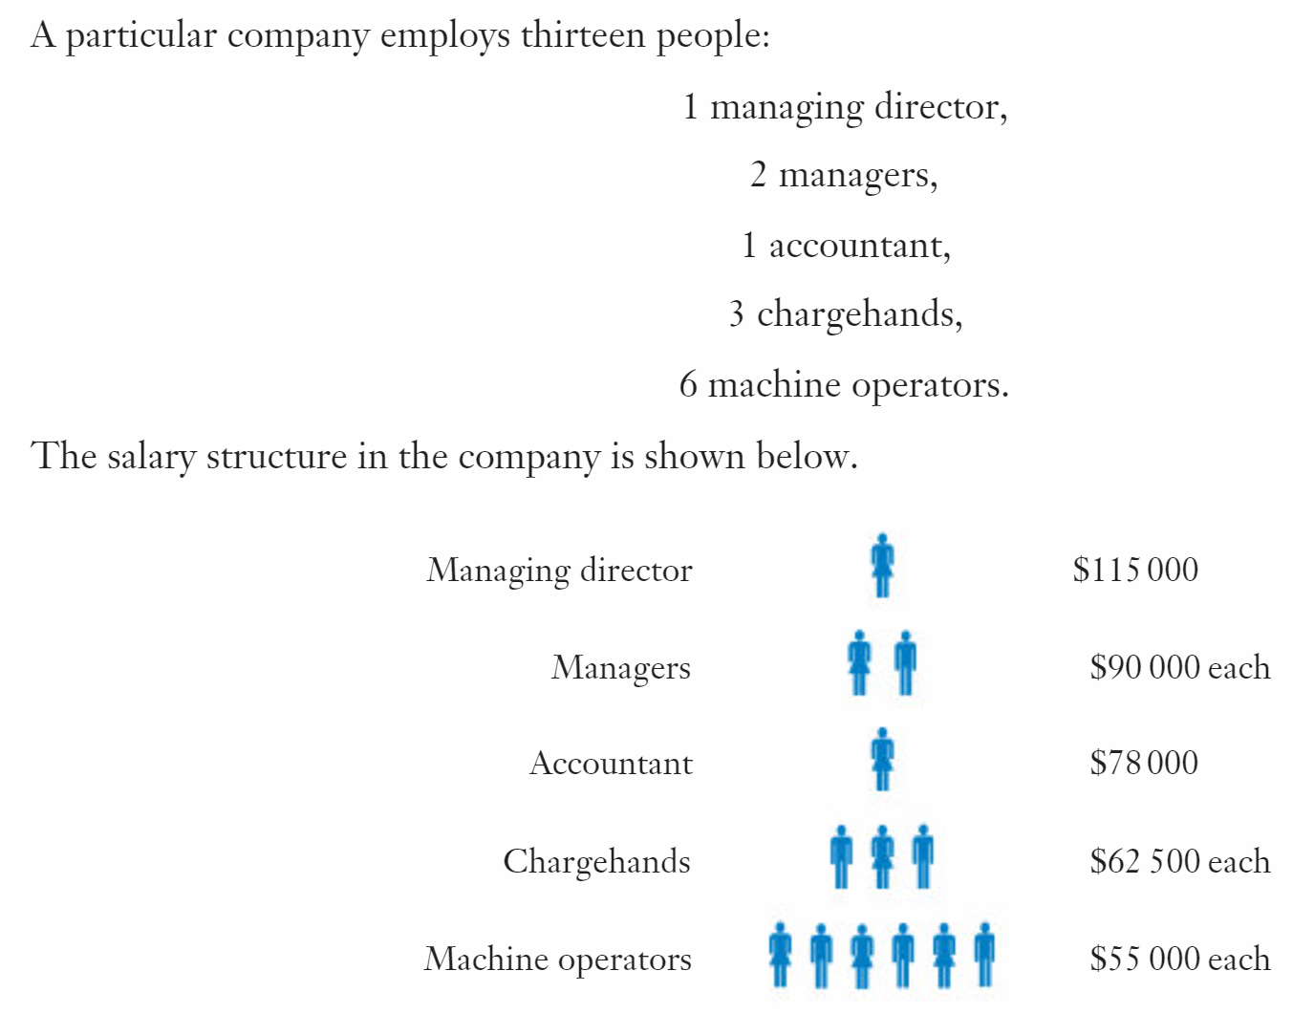
Scenario 1
Mean = $68 500
Median = $62 500
Mode = $55 000

Slide 8
Scenario 1
The group would use the mode, arguing that ‘most’ employees at the company only earn $55 000 a year.
Mean = $68 500
Median = $62 500
Mode = $55 000

Slide 9
Scenario 1
The managing director would use the mean, arguing that the ‘average’ employee at the company earns $68 500.
Mean = $68 500
Median = $62 500
Mode = $55 000

Slide 10
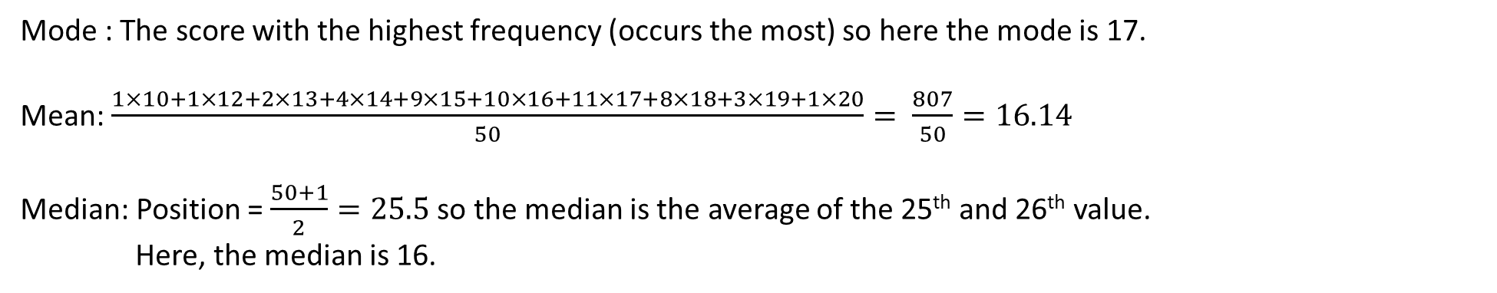
Example 1
The fifty scores shown below can be displayed in a frequency table.
Determine the mode, mean and median of the scores.
14 17 15 17 12 16 19 16 17 16
16 10 15 17 18 17 14 16 17 16
18 19 20 14 15 18 18 18 15 17
15 16 17 18 16 16 13 15 18 15
17 17 15 16 19 15 17 18 13 14
Mode : The score with the highest frequency (occurs the most) so here the mode is 17.
Mean: $\frac{1×10+1×12+2×13+4×14+9×15+10×16+11×17+8×18+3×19+1×20}{50}= \frac{807}{50}=16.14$
Median: Position = $\frac{50+1}{2}=25.5$so the median is the average of the 25th and 26th value.
Here, the median is 16.

Slide 11
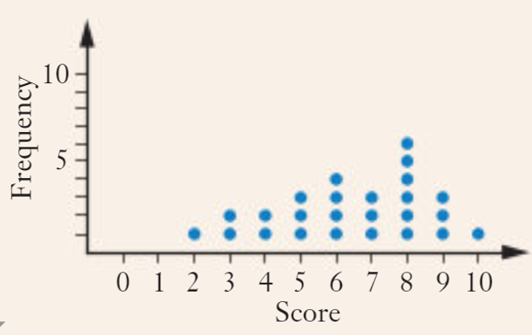
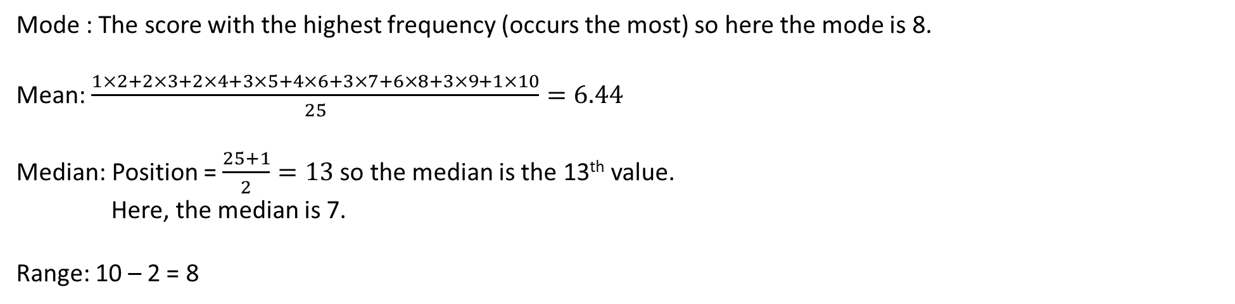
Example 2
Determine the mode, the mean, the median and the range for the data shown in the dot frequency graph.
Mode : The score with the highest frequency (occurs the most) so here the mode is 8.
Mean: $\frac{1×2+2×3+2×4+3×5+4×6+3×7+6×8+3×9+1×10}{25}=6.44$
Median: Position = $\frac{25+1}{2}=13$so the median is the 13th value.
Here, the median is 7.
Range: 10 – 2 = 8

Slide 12
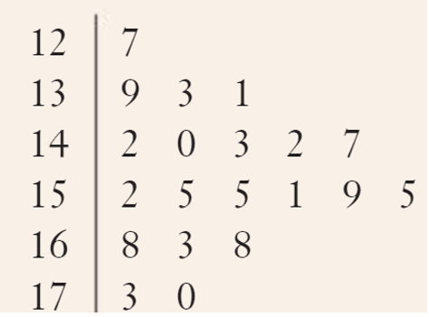
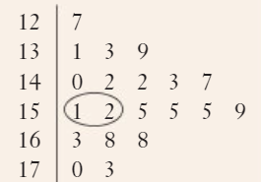
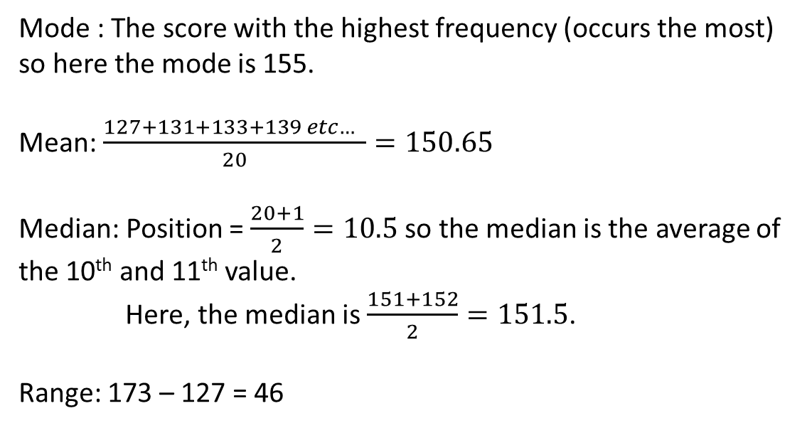
Example 3
Determine the mode, median, mean and the range for the 20 scores shown in in the stem and leaf diagram.
Order the leaves for each stem.
Mode : The score with the highest frequency (occurs the most) so here the mode is 155.
Mean: $\frac{127+131+133+139 etc… }{20}=150.65$
Median: Position = $\frac{20+1}{2}=10.5$so the median is the average of the 10th and 11th value.
Here, the median is $\frac{151+152}{2}=151.5$.
Range: 173 – 127 = 46

Slide 13
Example 4
Six scores have a mean of 23.5.
If the first five scores, were 17, 20, 19, 25 and 30, what was the 6th score?
$$\frac{17+20+19+25+30+x}{6}=23.5$$
$$\frac{111+x}{6}=23.5$$
$$111+x=141$$
$x=30$ The sixth score is 30.

Slide 14
Example 5
To pass a course, a student needs to gain a mean of 55% (or more) in the 5 tests taken during the course. The student got 46%, 57%, 54% and 57% in their first 4 assessments.
What percentage must they get in test five in order to pass the course?
$$\frac{46+57+54+57+x}{5}≥55$$
$$\frac{214+x}{5}≥55$$
$$214+x≥275$$
$x≥61$ They must get at least 61% to pass the course.

Slide 15
Example 6
In an exam, 15 girls in a class score a mean mark of 21.2. The ten boys in the class score a mean mark of 22.4
Calculate the mean for the whole class of 25 students.
The 15 girls achieved a combined total score of $21.2×15=318$marks.
The 10 boys achieved a combined total score of $22.4×10=224$marks.
The whole group achieved a combined total score of $318+224=542$marks.
$\frac{542}{25}=21.68$ The whole group scored a mean of 21.68 marks.

Slide 16
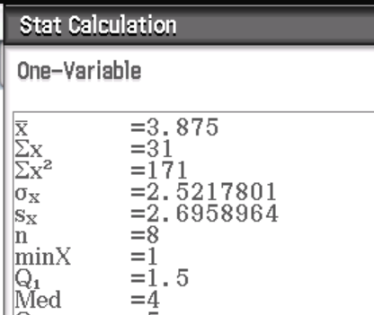
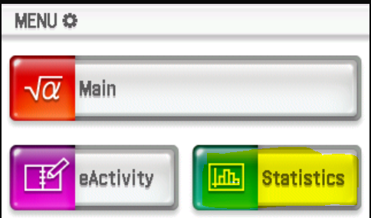
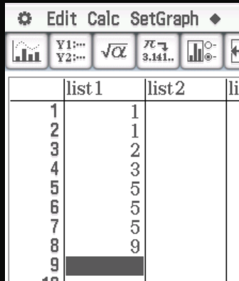
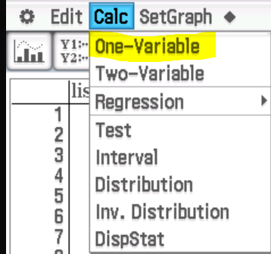
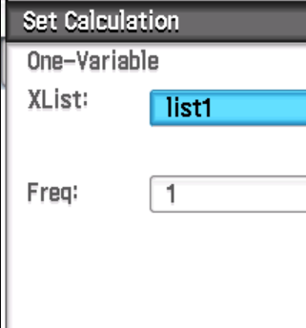
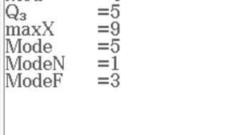
Calculating measures of centre and spread – using your ClassPad
1, 1, 2, 3, 5, 5, 5, 9

Slide 17
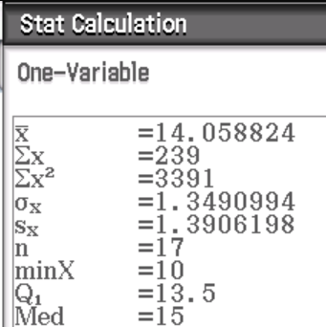
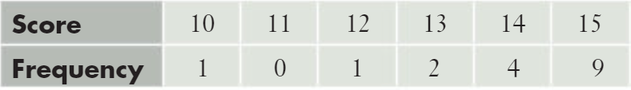
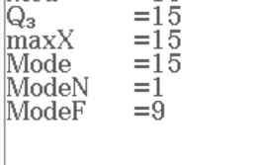
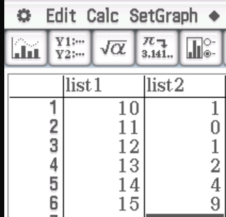
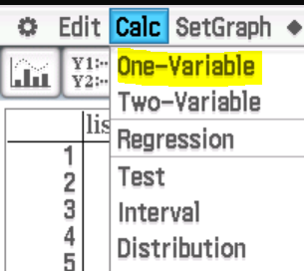
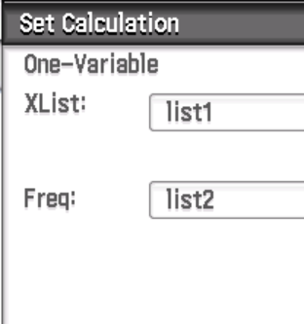
Calculating measures of centre and spread – using your ClassPad
Now do Exercise 2A

